Slide 2
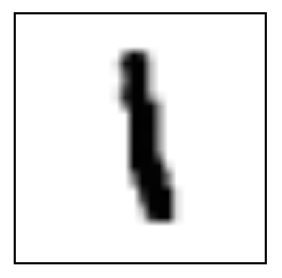
NN
…
…
…
Reshape
Input image:
28x28 pixels
Input shape:
Batch_size X 784
Output layer:
10 class
Hidden layer:
100 neurons
Input layer:
784 neurons
Feature extraction
Classification

Slide 3
CNN
Reshape
Output layer:
10 class
Convolution
5x5
Subsampling
2x2
Convolution
5x5
Subsampling
2x2
Input image:
28x28 pixels
Input shape:
Batch_size X 28 X 28 X 1
Hidden layer:
50 neurons
Feature extraction
Classification

Slide 4
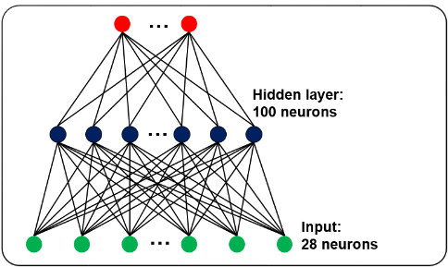
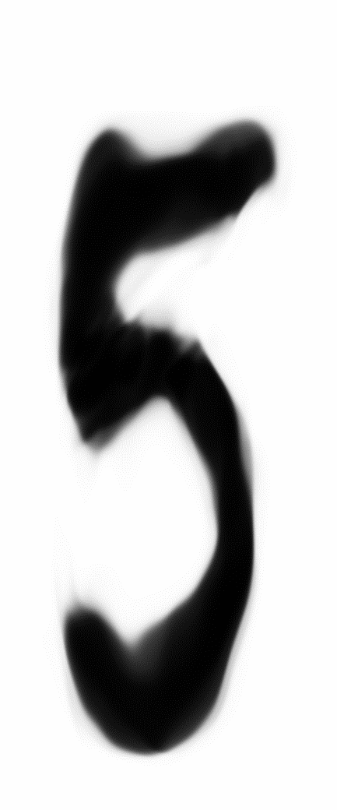
Classification
LSTM layer
hidden state:
100 nodes
N step : 28
Input sequence:
Batch size x 28 x 28

Slide 5
